Slide 1

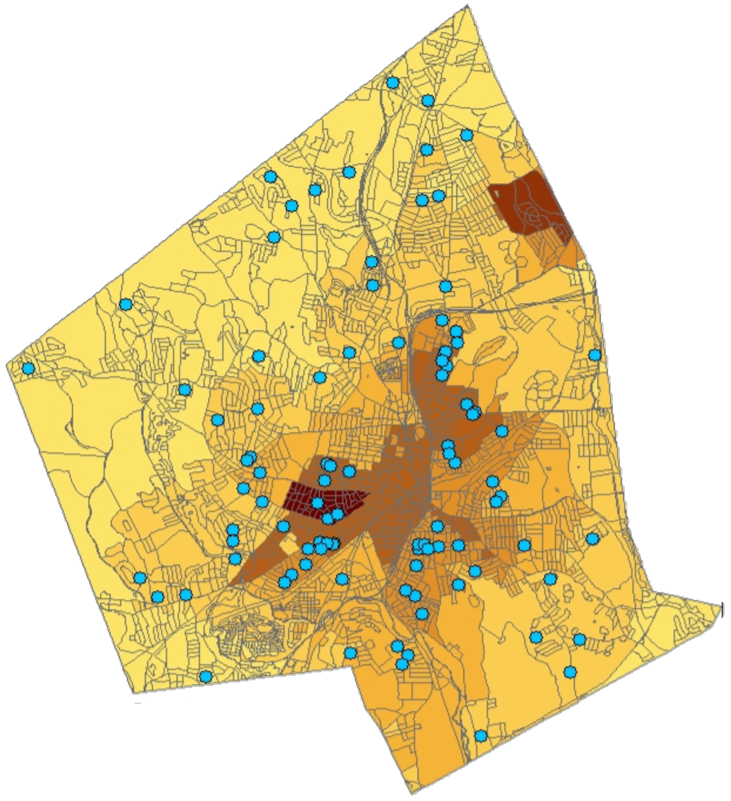
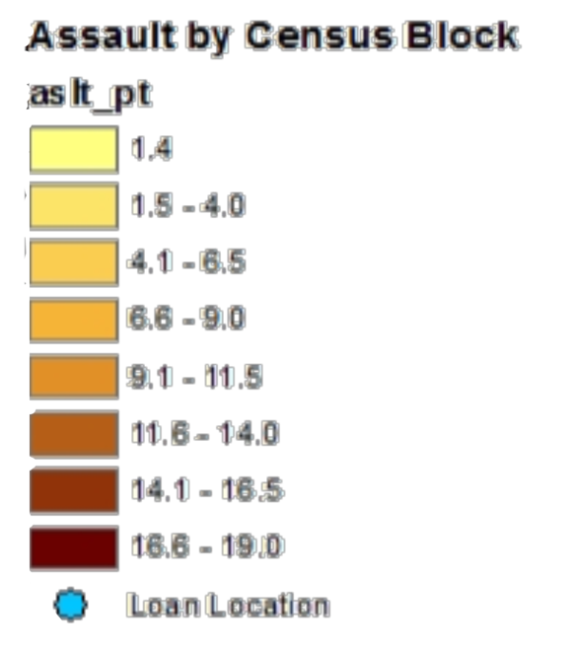

days
Positive Impacts of Housing Reinvestment In Worcester
Joseph Biasi ‘15– (Sponsor: Professor John Brown)
Question: Do small home improvement loans have a spill-over effect into the community?
Worcester’s Housing Market
A driving factor of Worcester’s housing market is its relationship with Boston. Worcester experiences a muted version of the growth in Boston, but suffers the same, if not worse, consequences in a recession. The plummeting home values and unemployment experienced during the financial crisis decreased homeowners home equity and capital leaving marginal homeowners unable to spend or borrow enough capital to maintain the same level of maintenance as they did before the crisis. Community Development Financial Institutions, or CDFI’s, have begun to address this problem.
WCHR Accepted Loan Locations
Comparing Groups and Time periods
The cases depend on two main variables: the ranking of the quality of the loan application and the period of time for the analysis of sales prices of homes. For the time variable, Cases 1 and 3 look at only the sales within one year from completion of the work while cases 2 and 4 take into account all sales that occurred either a year before the loan decision to anytime after the loan was made. For Credit Quality, Cases 1 and 2 use all applicants while cases 3 and 4 look at only those applicants who barely missed or made the cut.
Period of Analysis | Scope of Loan Granted/Denied
 | Includes All Applications | Includes Only Marginal Applications
Only sales during the effect period. | I: Only Sales within one year of work being completed | III: Only Sales within one year of work being completed and near marginal loans
Includes sales prior to the period when loans were/were not made | II: Only sales that occurred one year before loan decision or anytime after the decision. | IV: Only sales that occurred one year before loan decision or anytime after the decision and are marginal.
Case 1 and 2 Results
 | Mean (Std Dev) | Case 1 Ln(saleamount) | Case 2 Ln(sale amount)
Accepted | .4792 (.4996) | 0.0923 (3.1) | 0.0402 (2.12)
Age | 88.50 (37.21) | -0.00288 (-5.25) | -0.00219 (-8.42)
Fireplace | .2163 (.4118) | 0.195 (5.18) | 0.174 (9.32)
Total rooms | 10.25 (4.82) | 0.0431 (4.57) | 0.0432 (9.79)
Bathrooms | 2.287 (.8168) | 0.155 (1.43) | 0.124 (3.12)
Single Family | .5090 (.50) | 0.0968 (2.66) | 0.103 (4.37)
Three Family | .3530 (.4779) | -0.216 (-2.66) | -0.18 (-4.37)
Assault | 8.938 (3.935) | -0.0359 (-8.54) | -0.0363 (-13.47)
Loan Program
Over the last few years, Worcester Community Housing Resources, Inc, a local CDFI, conducted a new type of home improvement loan program with the aim of helping low and middle income home owners. Many of the applicants for these loans are facing increasing repair costs or foreclosure if these problems related to housing code violations are not fixed. Homes that are visibly in disrepair may have a negative effect on the sales price of surrounding homes and can prompt neighborhood decline.
Rules of Home Improvement Loans
Loan-to-Value Ratio Below 120% Factoring in Newest Mortgage
Applicant Below 120% of Area Median Income
Nature of Repairs Must be Vital, No Vanity Work
Funds Must Be Spent on Repairs
Only Trusted Contractors are Used
WCHR Sends its Own Representative to Ensure the Work is Done Well
Comparing Accepted Loans vs. Denied Loans
This thesis will be comparing the effects of loans with those of applicants that were denied. Denied loans are used to control the type of homeowner used to compare the effects of the loans because it constrains the target groups to those effected by similar homeowners or landlords. It also ensures a comparison between homes In similar home repair situations and social classes. Below are what the expected effects of getting a loan are compared to those with denied.
Accepted
Property Will Maintain Value
No Long-Term Negative Effects to Neighborhood
No Further Action Needed on Home
Denied
Property Value Will Decline
Surrounding Area Will Also See Decreasing Values
Municipal Liens and Foreclosure Possible
Higher Risk of Abandonment
Preliminary Statistics
Total Accepted: 97
Total Denied: 95
Declined Loans Foreclosed On: 12.5%
Denied Applicants able to get a different Mortgage: 13
Average Time from Denial to New Mortgage: 675 days
Regression Models
ln(Saleprice) = α+ β₁(accepted) + β₂(assault) + ∑^{i}₂(β_{i}x_{i}) + ∑^{i}₃(δ_{i}x_{i})+ε_{ij}
Hypothesis:
 | H₀: β₁ < 0 | H_{a}: β₁> 0
ln(Saleprice) = α+ β₁(accepted*Loan Amount) + β₂(accepted*Loan Amount)² + β₃(assault) + ∑^{i}₄(β_{i}x_{i}) + ∑^{i}₃(δ_{i}x_{i})+ε_{ij}
Hypothesis:
 | H₀: β₁ < 0 | H_{a}: β₁> 0
 | H₀: β₂ > 0 | H_{a}: β₂< 0
β_{4-I} and δ_{3-I} are additional variables associated with hedonic regressions such as number of rooms and type of home.
Interpretations:
Reject null hypothesis for all coefficients
All coefficients expected sign, year variables for first regression were not jointly significant and second regression were omitted for space
Primary focus on difference between coefficient of accepted in model 1 and 2
First regression represents sales within one year of work completion and second regression is extended time period
Second regression represents sales within 200 meters of applicant one year before loan decision and all time after. Indicates the difference between accepted and denied neighborhoods
The 5.21% difference between β1 in both regressions represent the estimated spill-over effect of the home improvement loans
Homes sold within one year of a loan and within 200 meters of an accepted loan were 9.23% higher than sales near denied loans

